Slide 1
Starting a new Indian Restaurant in Scotland
Murali Rajamanickam – May 2020

Slide 2
Introduction
Scotland is an outgoing nation, with high number of tourists:
The food and drink industry is worth around £14 billion.
Accounts for 1 in 5 manufacturing jobs in Scotland.
There is high potential in investment:
20% of new business fail in the first 2 years.
45% during the first 5 years.
In Scotland around 18% is born and 15% dies every year in the food industry.

Slide 3
Study Highlights
Factors deciding the decision making:
1. The city where the restaurant is located (the ratio of restaurant facilities to amount of population)
2. The area where the restaurant is located (the amount of restaurants located in a certain area)
3. The type of food served (the cuisine served should be unique or least represented in the area of choice)

Slide 4



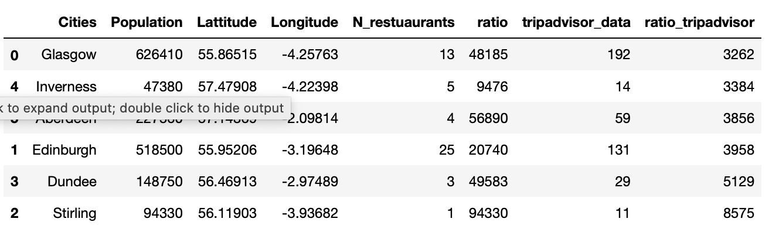
Data Acquisition and cleaning
Initial study had major issues regarding the obtained data.
Problems encountered:
Foursquare doesn’t contain all data for all the restaurants in Scotland.
The number of restaurants observed in uneven when compared to tripadvisor.
Decision based on Foursquare will not be relevant.
Glasgow picked to carry out the study

Slide 5
Initial Analysis
Initial analysis with top 5 venues was impossible.
Many postcodes don’t have 5 restaurant types.
The decision of only choosing top 3 was made.

Slide 6
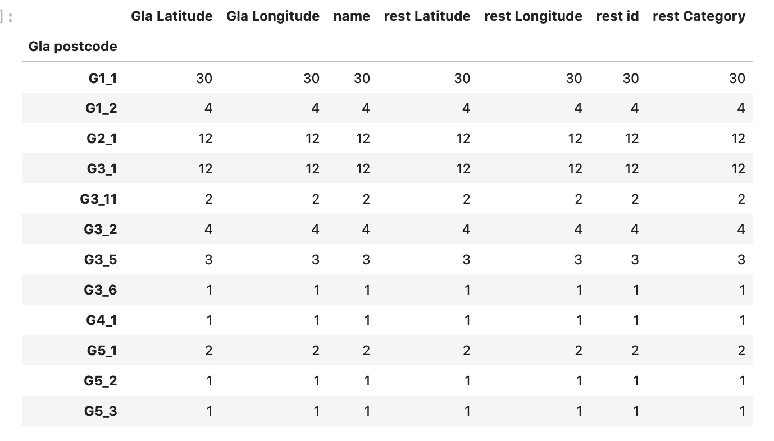
Initial analysis
Only the postcodes containing at least 3 restaurants were selected.
The others were discarded.

Slide 7
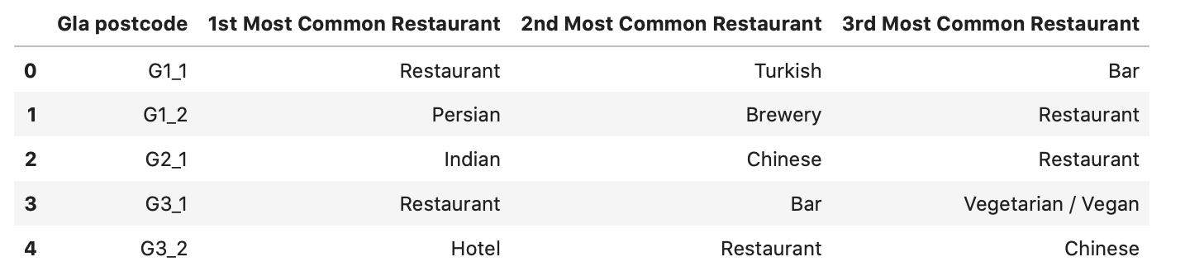
K-Means clustering
An example of K-means clustering result as observed.
Top three of restaurant types presented for each postcode point.
Clusters from 3 to 5 were explored.
5 clusters was the most suitable

Slide 8
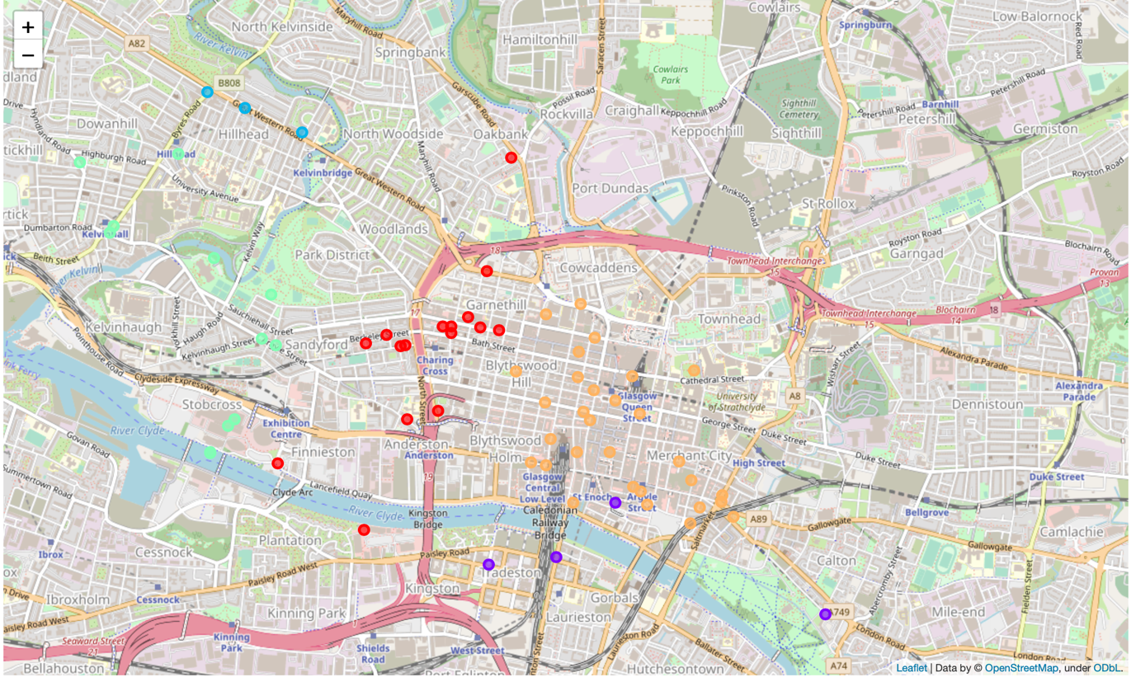
5 clusters map of Glasgow
Clusters 2 turquoise and 4 orange have the highest potential (many restaurants with no Indian restaurants)
Cluster 0 in red has no potential (many Indian restaurants)
Cluster 1 and 3 have little interest (low presence in restaurants but no Indian)
Cluster 2 in turquoise is the preferred area of choice of a new Indian restaurant

Slide 9
Conclusion
Data provided by Foursquare is poor.
Analysis of Glasgow carried out with success.
East End area of Glasgow has been defined as the most suitable to start a new Indian restaurant.
Merchant City is also another suitable are of interest.

